Slide 1
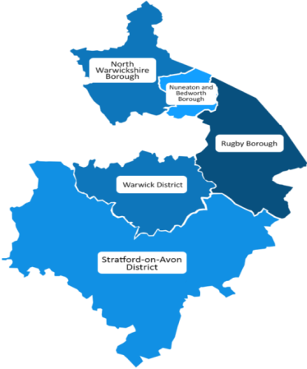
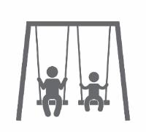
Notes:
Welcome on behalf of the Warwickshire Safeguarding Board. Explain these workshops have been commissioned by the board, they are multi-agency facilitated and audiences are aimed to be multi agency.
Slides 1-4 and introductions from 9am- 9:10

Slide 2
Welcome and introductions
Welcome and housekeeping
Introductions
Our proposals
How to take part in the conversation

Slide 3
Why are we here?
We have to change the way we deliver services for children and families so they are:
Fit for the future
Financially sustainable
Protect the most vulnerable
Flexible and adaptable to all needs
To do this successfully we need your views

Slide 4
Our commitment
This is a consultation: we know families, professionals, partners and communities often have the best ideas about practical ways forward. This consultation period allows us to talk to you and listen to your views, ideas and issues
The proposals are not simply about saving costs: the Council is facing financial challenges. These proposals mean most of the savings will come from using fewer buildings – allowing us to focus our resources on the services themselves and the families who need them
We are absolutely focused on providing the best early years and early help for Warwickshire children: we have spent two years researching what works in early years and our proposals build on this research while developing a model that focuses on the whole family
The safety of children will always be our key priority: safeguarding and safety will be front and centre of our proposals

Slide 5
History how we got here
2000: Government launches Sure Start and introduction of children centres aimed at reducing child poverty. Focused on most deprived areas - but open to all families living in the catchment area
2004 – 6: 13 children centres opened in greatest area of need in Warwickshire
2006 – 8: 17 more centres in next tier of need
2008 – 10: another 9 centres opened in county

Slide 6
Our proposals transforming services for the under fives
2015: launch of Warwickshire County Council Smart Start Programme – 1,500 professionals, families and staff involved
Involved talking and listening to families, partners, experts and key organisations
Provided one off funding for specific projects, work to find out what was happening in communities already and what people wanted for their communities
Research into what’s working elsewhere in the country and best practice
You told us that you:
want services to be joined up and accessible
value family support work
value building relationships and networks within your community
This work has helped us shape our latest proposals

Slide 7
The Big Picture
Part of wider transformation of Children and Families to provide the right support for the right issue at the right time.
Family Hubs will be linked with the wider service offer
Part of wider transformation of how the County Council will engage with communities through community hubs and delivery of services in the future
We are very keen to work with communities and current providers on proposals for community run options

Slide 8
Context where we are now
By 2020 Warwickshire County Council will have had more than £200million a year taken from its annual budget. Between now and 2020 we need to find savings of £67million.
Budget for children centres has reduced over five years – from £7.8 million a year in 2012 to £4.8 million a year in 2014
So far savings have been found through reducing some services and different ways of commissioning the services from outside
We now need to find a further £1.12 million savings from children centre budgets as part of the £10 million a year savings from the overall children and family services budget.
Our budget for children centre from 2018 will be £3.7 million a year

Slide 9
From Children’s Centres to Family Hubs
Currently 39 Children’s Centres across the County providing varying levels of service across the County
Now seeking to deliver an enhanced offer from fewer sites that extends the age range from the current 0-5 to 0-19/25
Prioritise services rather than buildings with greater reliance on out-reach sites that you currently use
A partnership approach where services from different agencies are delivered in a joined up manner
In practice this will mean :
12 family hubs proposed in the areas of highest need across the county. The consultation will help us work out which services you want and need
All age, whole family approach to support with greater links with the community and voluntary sector
We want to explore the potential for the remaining children centres to continue with some services but with transferred management (like some libraries across the county). These could operate as “spokes” to the 12 key family hubs.

Slide 10
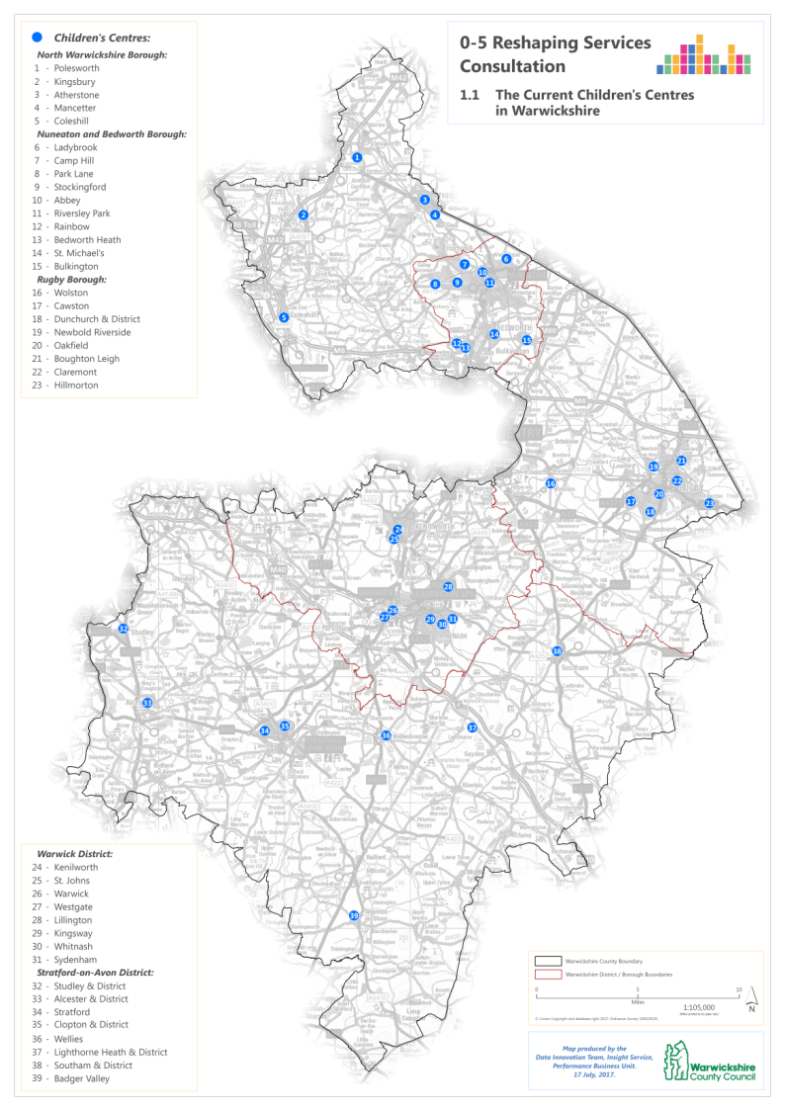
What this means in your area
Current provision
Across the county

Slide 11
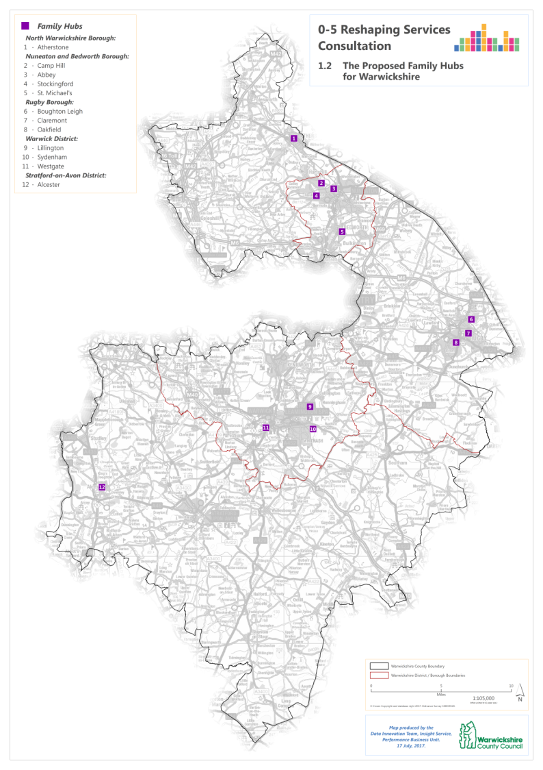
What this means in your area
Proposed Family Hubs
Across the county

Slide 12
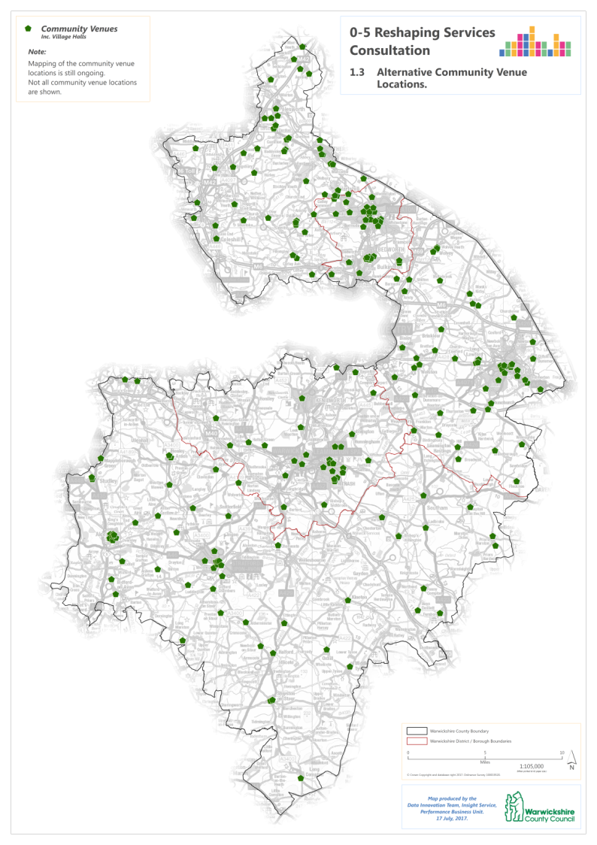
What this means in your area
Community venues
Across the county

Slide 13
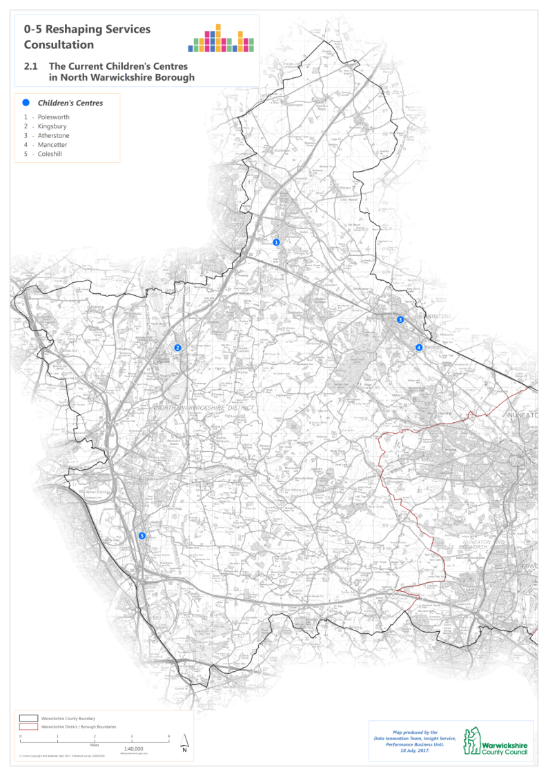
What this means in your area
Current provision
North Warwick-shire Borough

Slide 14
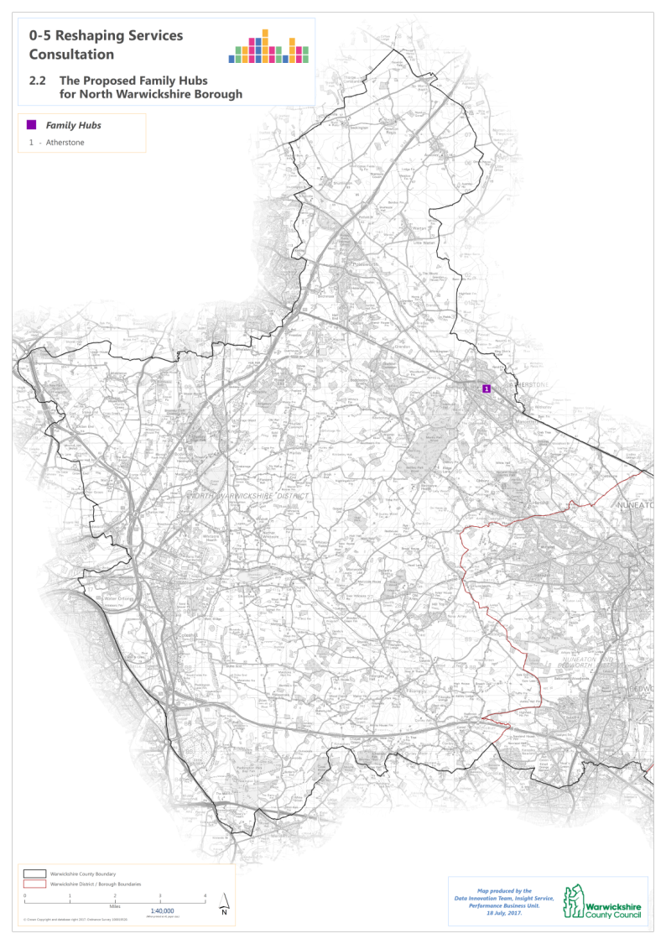
What this means in your area
Proposed Family Hubs
North Warwick-shire Borough

Slide 15
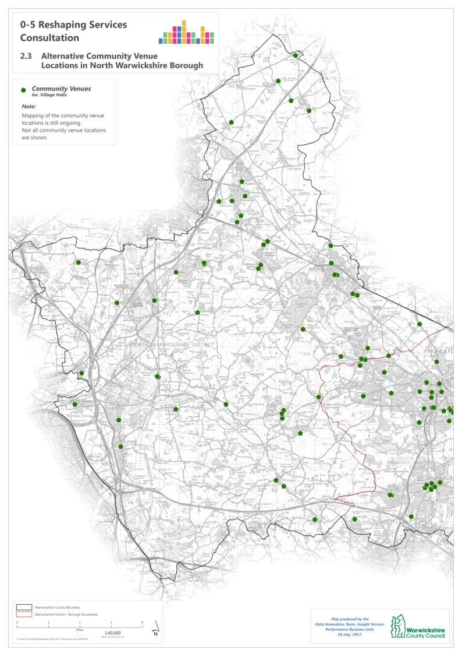
What this means in your area
Community venues
North Warwick-shire Borough

Slide 16
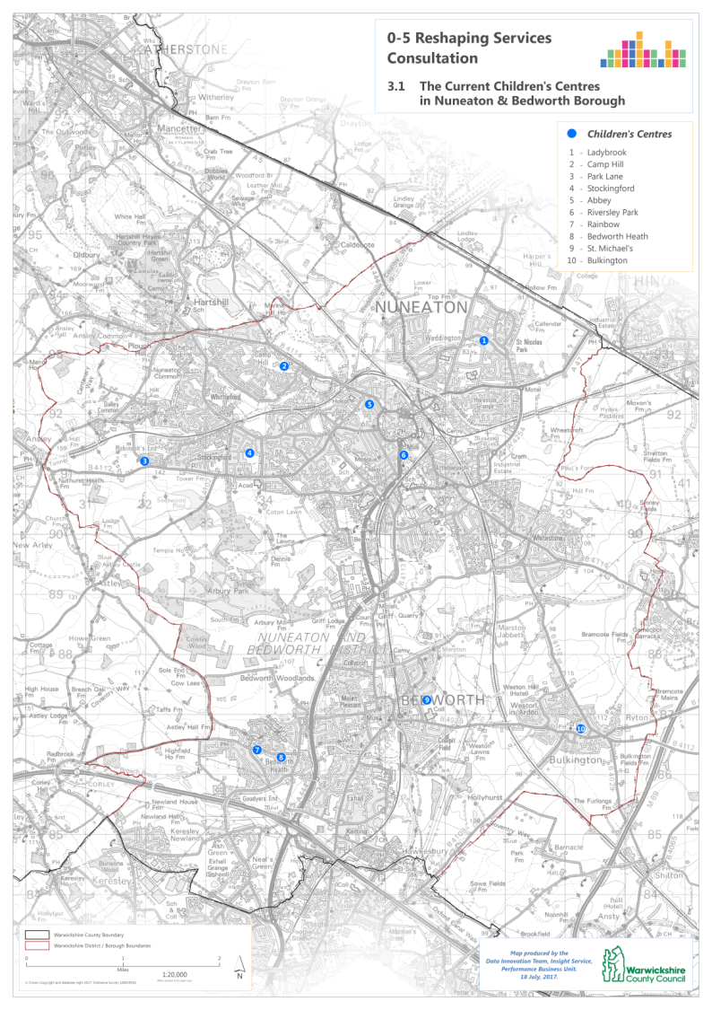
What this means in your area
Current provision
Nuneaton & Bedworth Borough

Slide 17
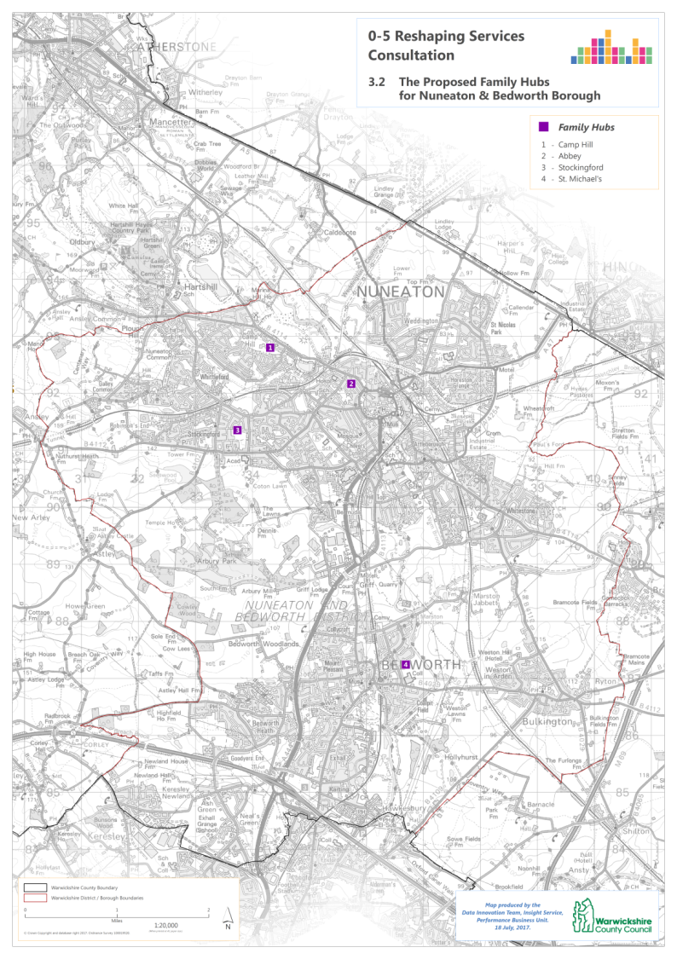
What this means in your area
Proposed Family Hubs
Nuneaton & Bedworth Borough

Slide 18
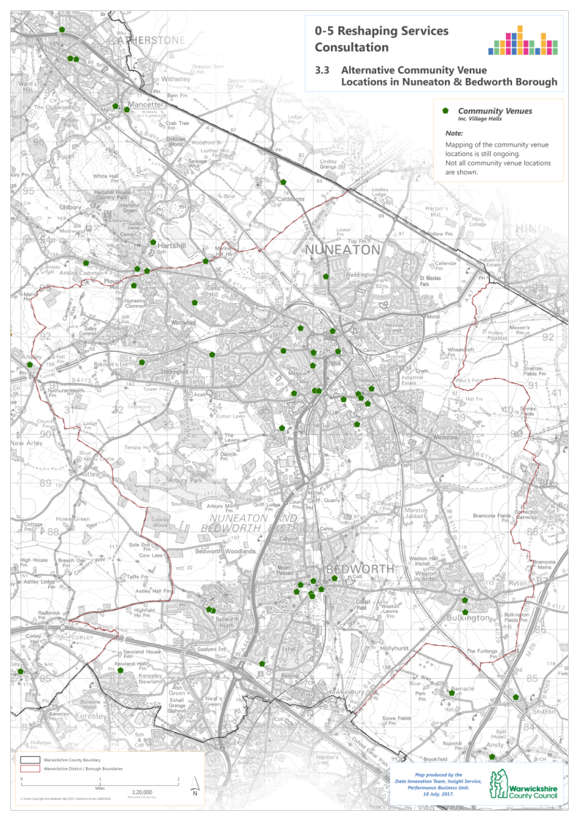
What this means in your area
Community venues
Nuneaton & Bedworth Borough

Slide 19
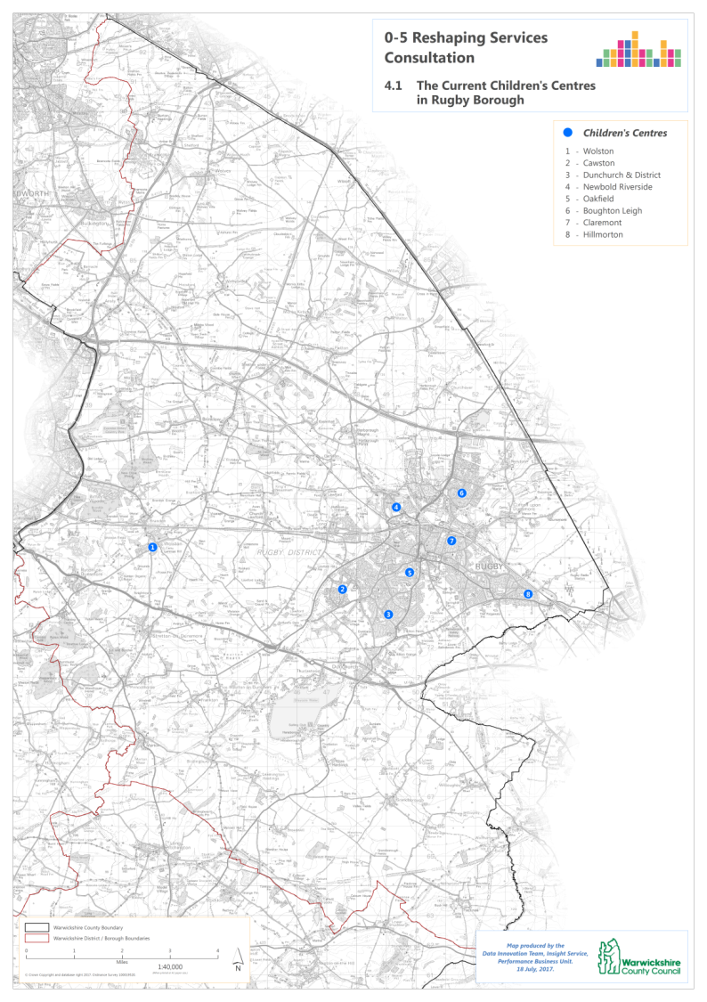
What this means in your area
Current provision
Rugby Borough

Slide 20
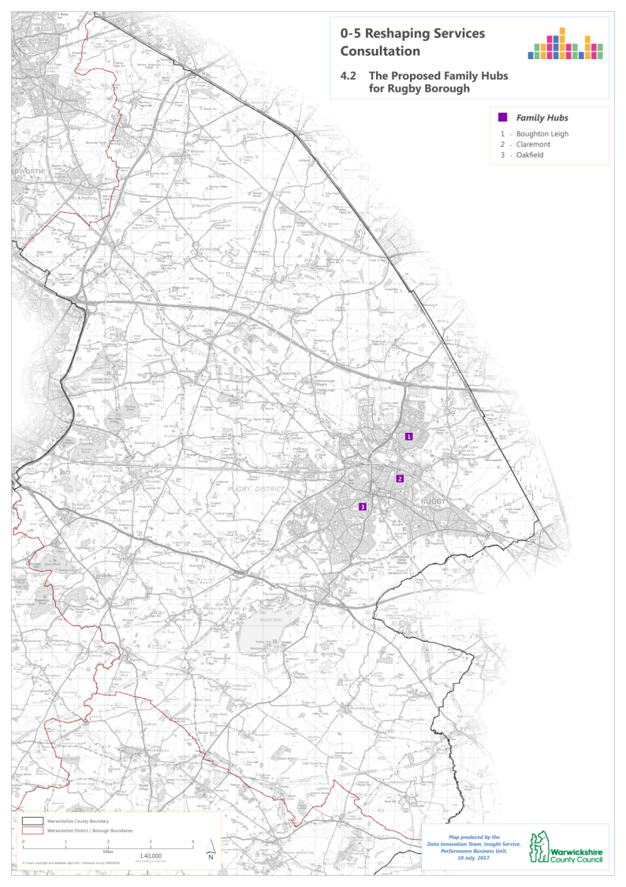
What this means in your area
Proposed Family Hubs
Rugby Borough

Slide 21
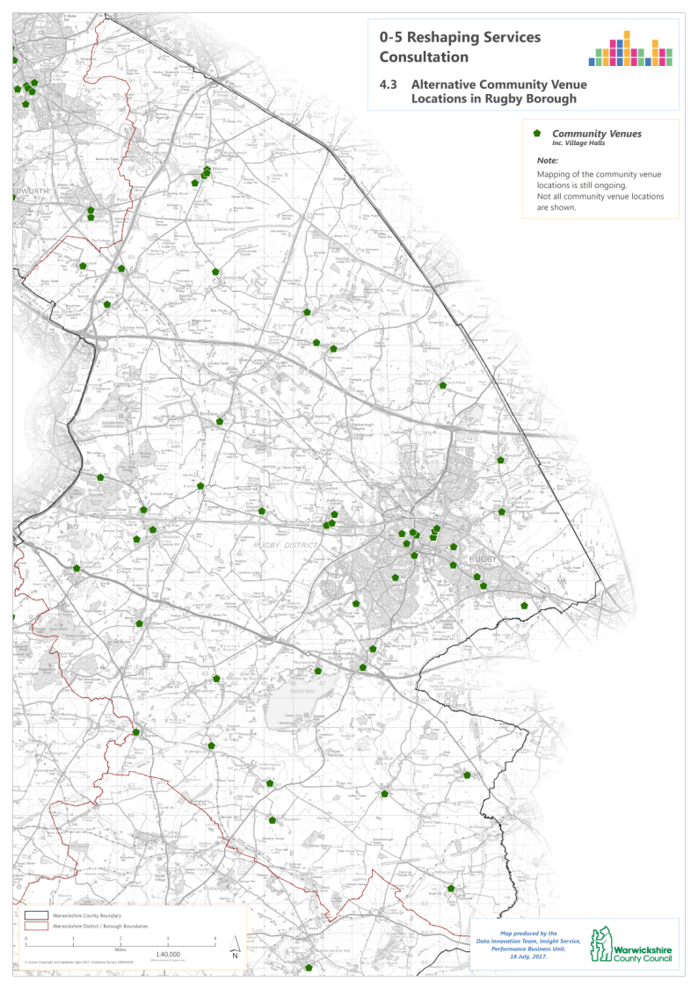
What this means in your area
Community venues
Rugby Borough

Slide 22
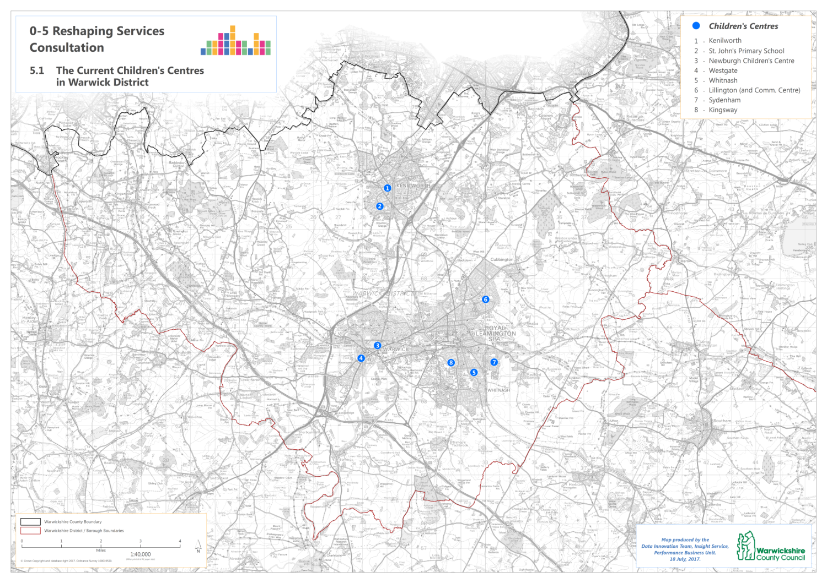
What this means in your area – Warwick District
Current provision

Slide 23
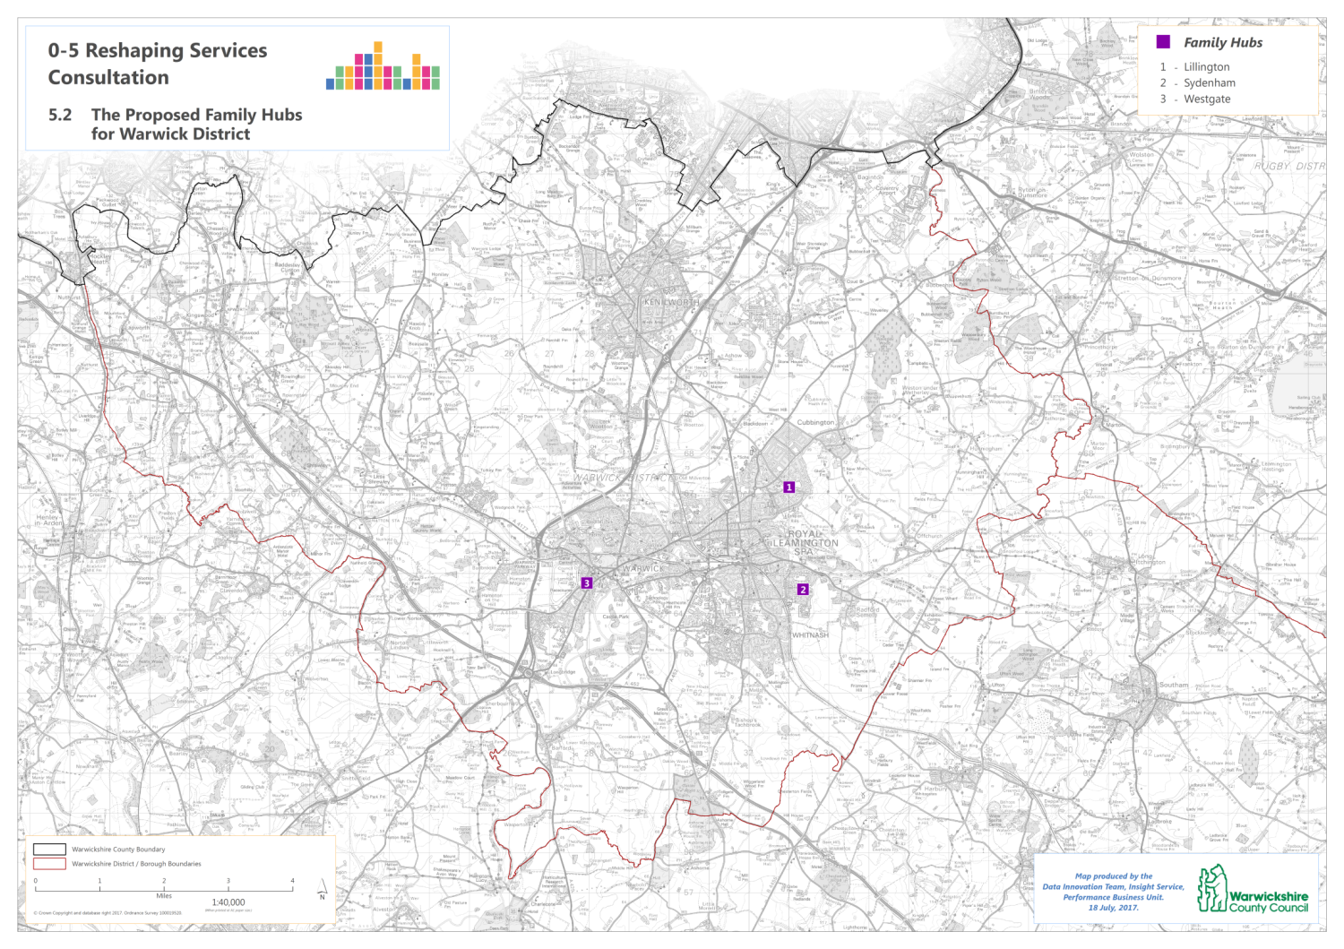
What this means in your area – Warwick District
Proposed Family Hubs

Slide 24
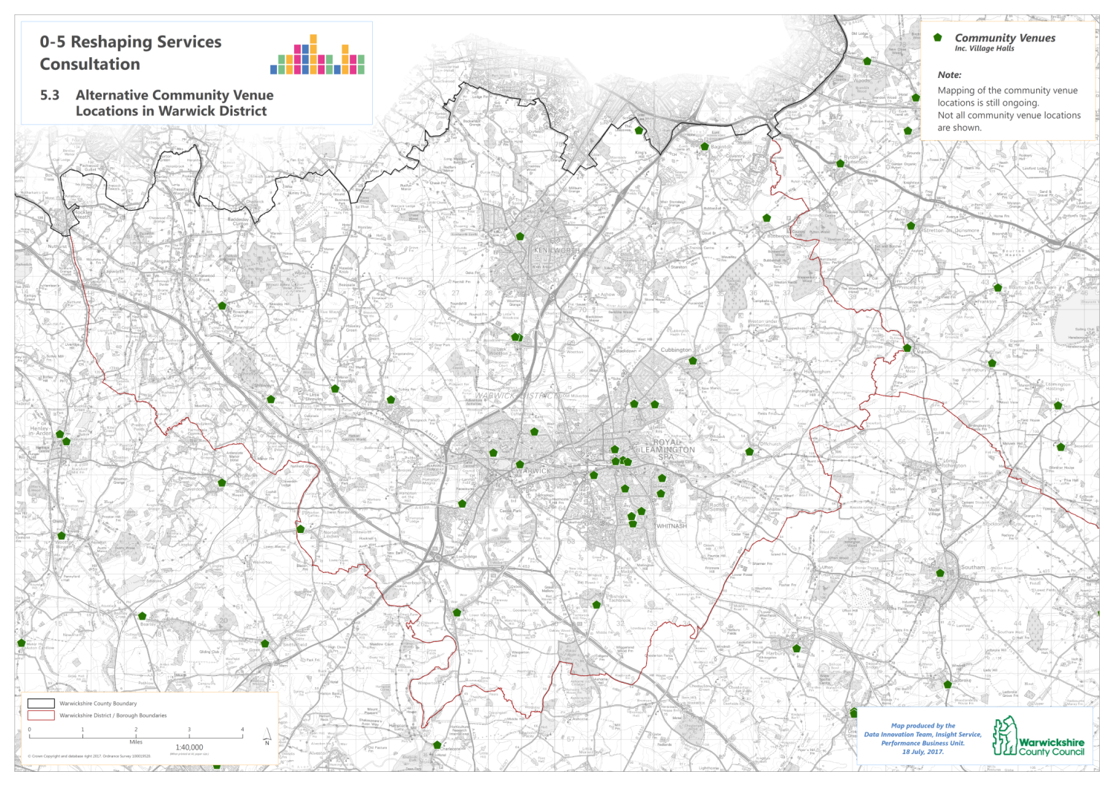
What this means in your area – Warwick District
Community venues

Slide 25
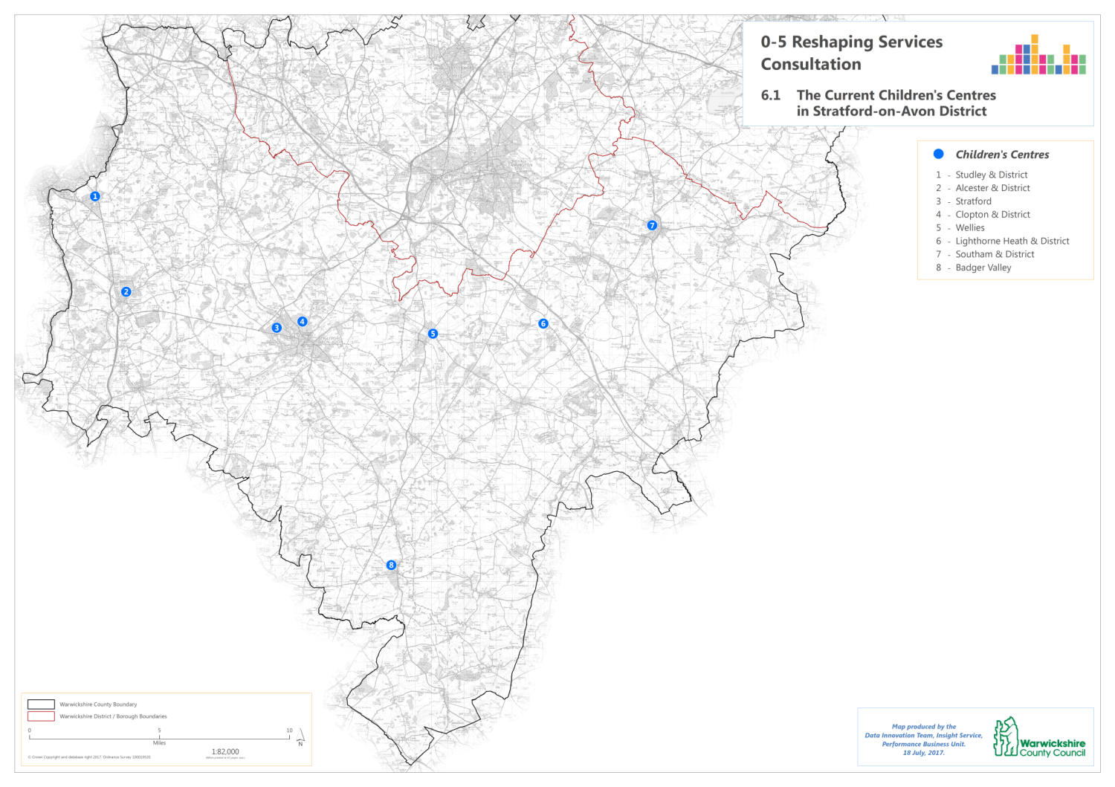
Stratford-upon-Avon District
What this means in your area
Current provision

Slide 26
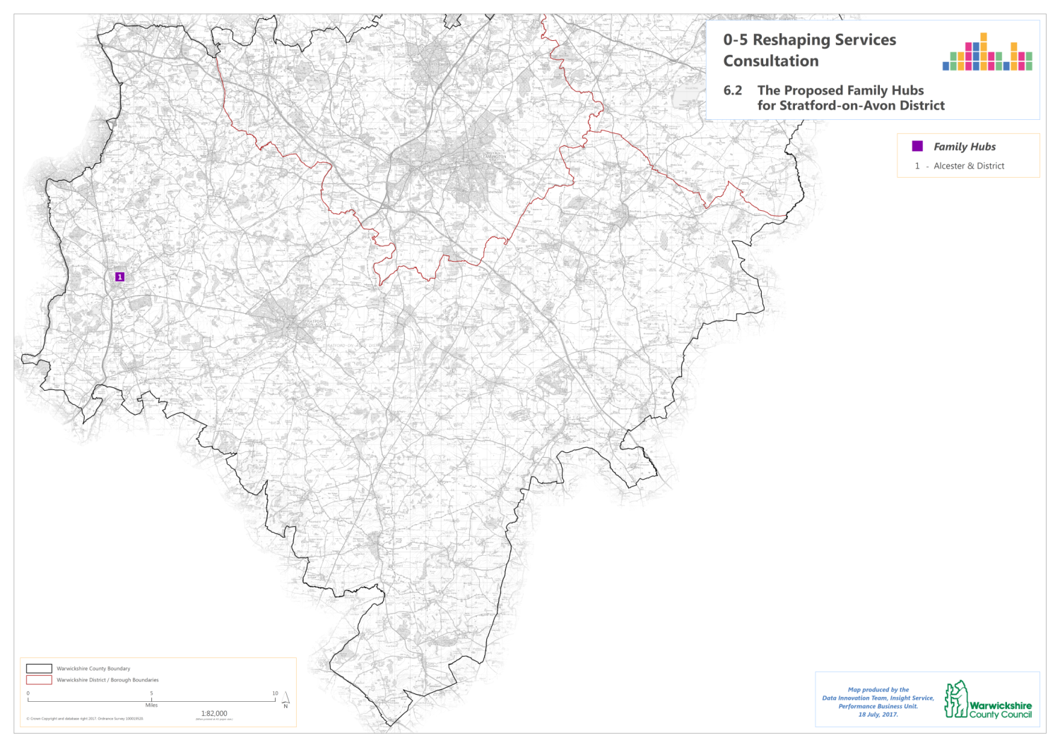
Stratford-upon-Avon District
What this means in your area
Proposed Family Hubs

Slide 27
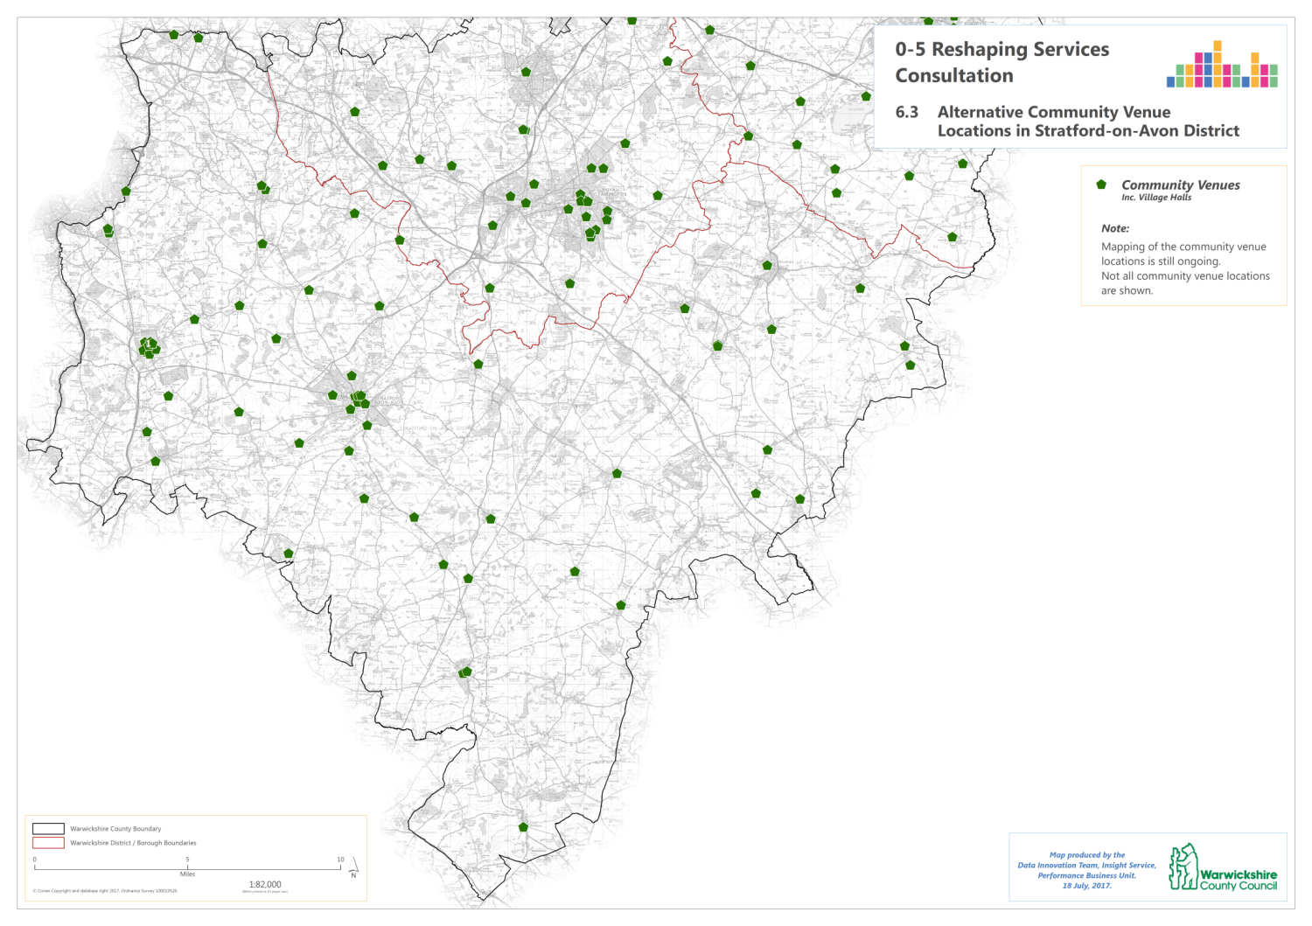
Stratford-upon-Avon District
What this means in your area
Community venues

Slide 28
Being part of the conversation – how to get involved
Your opportunity to ask questions and raise issues at this forum
Fill in the questionnaire online
www.warwickshire.gov.uk/familyhubsconsultation
The consultation information is also available in alternative formats via:
familyhubs@warwickshire.gov.uk or
phone 01926 742350

Slide 29
Next steps
Expected timeline:
Consultation end date: 11/09/17
Analysis and reporting followed by recommendations to Cabinet: Autumn 2017

